Slide 1
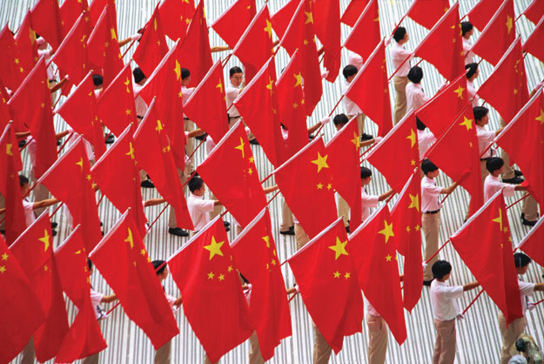
National Critical Intelligence Estimate presented by Intelligentia Securitatem Machinis
China
Source: http://www.foreignpolicy.com/articles/2010/01/04/123000000000000
Conjunctive effort with:
Professor Randall Nichols
CYB 610 Z3-UPDATED MELQUIST/SPYGLASS-2017/02/27

Slide 2
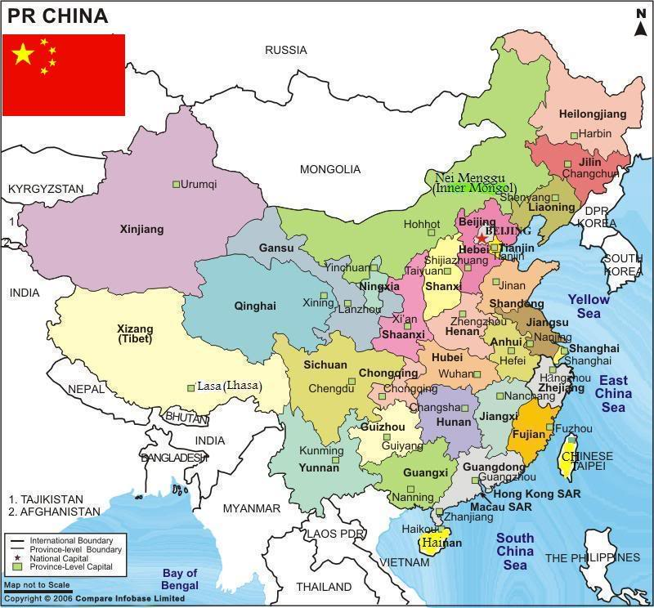
Source: http://www.google.com/imgres?imgurl=http://www.travelchinaguide.com/images/map/china/china-map-2-m.gif&imgrefurl=http://www.travelchinaguide.com/map/&h=634&w=536&sz=55&tbnid=xbRwzuQycBUgXM:&tbnh=90&tbnw=76&zoom=1&usg=__CGg1P2iL54wqE8gQoneghqTGbFA=&docid=fEvPCbaXP2g7vM&hl=en&sa=X&ei=o-Q8UaTXGI2i8AT_moGgCQ&ved=0CD4Q9QEwBQ&dur=352

Slide 3

Co-Leadership
Graig Lundy Joseph Davis
Political/Military Economic/Cyber
Executive Officers
Brett Heidenreich Joey Quinn
Military Cyber
Team Members
Politics Economy
Kelly Boek Steve Martin
Military Cyber
Alex Nobles Trevor Nowalk

Slide 4
Agenda
Executive Summary
Political, Military, Economic, Cyber
Political / Diplomatic
Facts
Key Judgments
Military
Facts
Key Judgments

Slide 5
Agenda (cont)
Economic
Facts
Key Judgments
Cyber
Facts
Key Judgments
Countermeasure Recommendations
References

Slide 6
Executive Summary Political Estimate
The Chinese Communist Party (CCP) runs China authoritative leadership - chosen by the CCP
The CCP uses it’s political influences to control
Military
Business
Opposing political views
Information and Education
To advance within China, CCP membership is seen as a necessity.
New technological advances are beginning to show signs of influence in government

Slide 7
Executive Summary Military Estimate
Military controlled by the CCP
Ministry of Defense is a front
Central Military Commission used to command PLA
Vast expansion of military budget
Modern tactics and technology expansion in recent years
Continued growth based on large number of citizens
Division of branches based on need
Air force, Navy, Ground Forces, Artillery
Military includes People’s Armed Police and Reserve Forces

Slide 8
Executive Summary Economic Estimate
Continual SOE focus will drive currency devaluation causing negative impact on private venture capital
Slowing economic growth and on pace to become world’s top economy; no shift from SOE mainstream apparent
Extensive borrowing by local governments and non performance indicates potential for growth in unemployment; labor unrest likely to increase
Labor costs are likely to diminish after economic peak compounded by massive population
Private consumption at all time low and little disposable income; lack of social safety net drives consumer saving
Expanded economic growth perceivable, more FDI and elevated rate of trade dependence
Overdependence on exports and fixed investing, pollution and environmental exhaustion, social disadvantages and worsening conditions for lower class
Governing perspective on Military prowess neglectful of economic devotion

Slide 9
Executive Summary Cyber Estimate
Concentrated effort to excel on Information war fronts
Massive espionage undertaking
Offensive onslaught of hacking directed toward corporate and government entities
Loss of information on an exceptional level from many jurisdictions
Specialized units for cyber offense and defense
Top tier cyberwarfare power achievable
Personnel to execute attacks on monumental level
Huge expenditure and possible burden to economy for cyber agenda
Mandatory direction required for computer and technology students
New technology and potential ahead of adversaries
Next generation of well trained professional leaders in cyber
Potential global leaders in hardware and software
Leaders in New Domain/ Lead superpower
Social disassociation from Communism
Public Unrest
Government forced into green technology and better human rights
Require global participation to maintain agenda

Slide 10
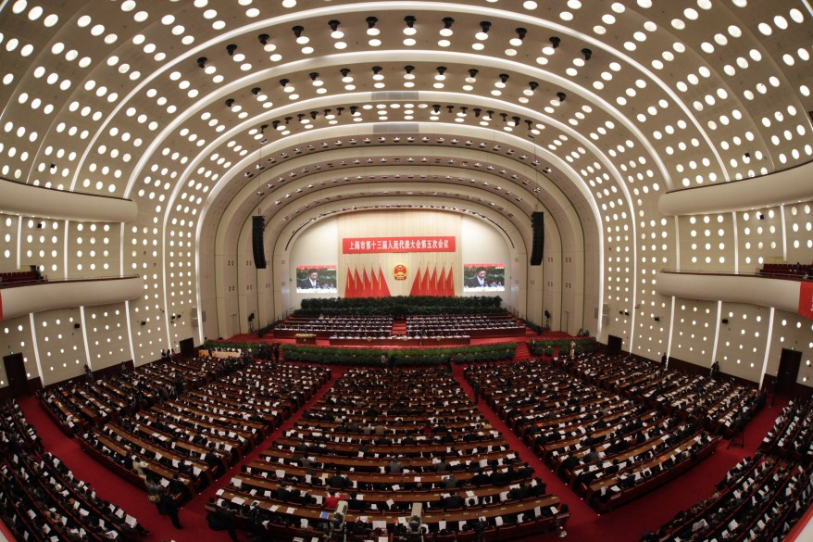
Chinese Politics
Source: http://blogs.voanews.com/photos/2012/01/11/

Slide 11
“No organization or individual has the special right to overstep the Constitution and law, and any violation of the Constitution and the law must be investigated.”
~Communist Party General Secretary Xi Jinping

Slide 12
POLITICAL/DIPLOMATIC
Only Communist Party-led state in the G-20 grouping of major economies
China’s Communist Party dominates state and society
China’s leading political institutions
Communist Party/Military
People’s Liberation Army
The State (State Council)
The National People’s Congress (NPC)

Slide 13
POLITICAL/DIPLOMATIC
Legislature
Controlled by Communist Party
Led by seven Politburo Standing Committee members
Military is NOT considered an army, but a part of the Communist Party
Communist Party has 8 “minor” political parties

Slide 14
POLITICAL/DIPLOMATIC
There are eight other minor political parties
used to argue a “multi-party cooperation system”
combined members is fewer than 1 million
CCP caps yearly new members
Required to accept the permanent leadership of the Communist Party
Expected to work “hand in hand” with the Communist Party
develop socialism with Chinese characteristics
barred from operating as opposition parties

Slide 15
POLITICAL/DIPLOMATIC
Party Policy
Mandates that all Chinese people are bound by Constitution and Communist Law
Eliminates and rejects:
Multi-party systems
Separation of powers
Bicameral legislature
Federal system

Slide 16
POLITICS/DIPLOMATIC
Chinese Communist Party (CCP)
63 years of power in China
Now called the People’s Republic of China (PRC)
It is the leadership system of the party and state

Slide 17
POLITICAL/DIPLOMATIC
CCP
Any Chinese citizen can apply for party membership
Must be over the age of 18
Must accept and abide by the party’s constitution and policies
Participation in activities of the party requires
Members belong to a group, cell or specific unit of the party
Party bodies can wield great power
Even with having little formal authority

Slide 18
POLITICAL/DIPLOMATIC
CCP (cont)
CCP controls all avenues for public sector advancement
Many young people join the party for career reasons
The party membership is mostly male
less than a quarter of the membership represented by women
The CCP controls information through propaganda and restriction of non party opposition
Jockeying among leaders is common at every level of the system

Slide 19
POLITICAL/DIPLOMATIC
CCP Structure
Politburo Standing Committee
Main Decision and Policy Making Entity
Politburo
Second Level Decision and Policy Entity
Central Committee
“Elect” the Politburo
Party Congress
Elects the Central Committee members

Slide 20
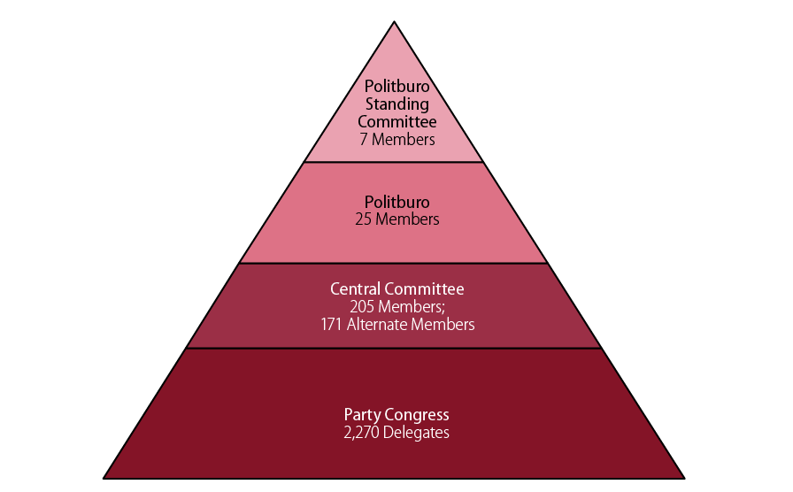
POLITICS/DIPLOMATIC
Source: www.fas.org/sgp/crs/row/R41007

Slide 21
POLITICAL/DIPLOMATIC
Politburo Standing Committee
7 members ranked 1-7
Head specific groups
To ensure party control, the top-ranked members of the PSC serve concurrently as the heads of other parts of the political system

Slide 22
POLITICAL/DIPLOMATIC
Politburo
25 members
Includes the 7 member Politburo Standing Committee
2nd highest policy making group
The full Politburo is not involved in day-to-day decision-making
Meetings are sporadic
Focus on a single major policy area or preparations for major national meetings

Slide 23
POLITICAL/DIPLOMATIC
Central Committee
205 Full members – 171 Alternate members
“Elect” the Politburo, Politburo Standing Committee, and Party General Secretary
“Decide” on the composition of the Party’s Central Military Commission
In actuality, top officials provide a list of nominees to be ratified

Slide 24
POLITICAL/DIPLOMATIC
Party Congress
2270 delegates
Elect Central Committee members once every 5 years
12th session of the National People’s Congress – March 2013
Approve the Party General Secretary’s report to the Congress
Is a statement of the party’s positions
Outlines the Party’s agenda for the coming five years
Required to meet at least once a year, known as a plenum
Plenums focus on setting the direction for the country in a specific area
Approving major personnel decisions

Slide 25
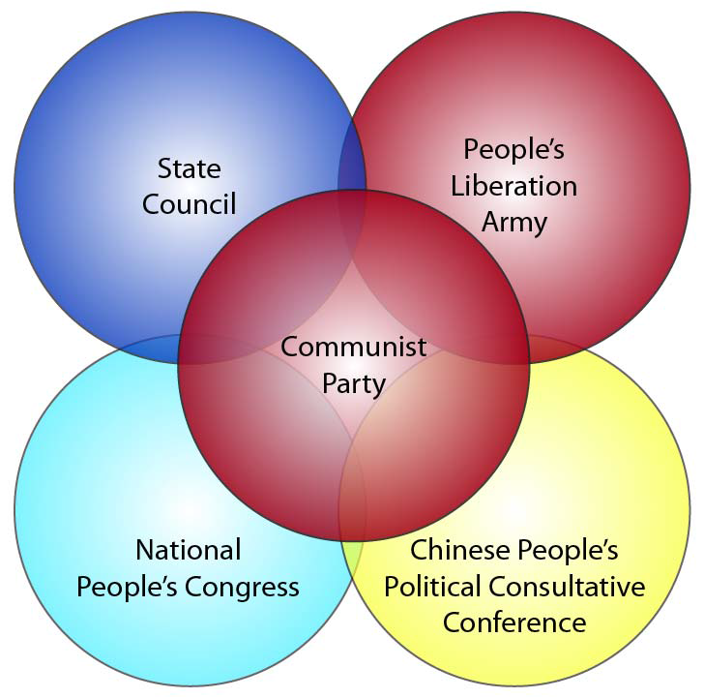
POLITICAL/DIPLOMATIC
Overview of China’s Leading Political Institutions
Source: www.fas.org/sgp/crs/row/R41007

Slide 26
POLITICAL/DIPLOMATIC
The State Council
Dominated by Four Pillars of Power
Control of 2.25 million person military
The People’s Liberation Army (PLA) also known as China’s military
Control over personnel appointments across all political institutions, military, public institutions & the media
Full control over the judiciary system

Slide 27
POLITICAL/DIPLOMATIC
National People’s Congress (NPC)
Oversees State Council, the Presidency, the Supreme People’s Court, the public prosecutors’ office & the military
Approve all budgets, agency reports and personnel appointments, and initiate and shape legislation

Slide 28
POLITICAL/DIPLOMATIC
Party & State consult with two “sets” of institutions
People’s Political Consultative Conferences (PPCCs)
Chinese People’s Political Consultative Conference (CPPCC) National Committee
China’s eight minor parties otherwise known as China’s “democratic parties”
“multi-party cooperation and political consultation led by the Communist Party of China”

Slide 29
POLITICS/DIPLOMATIC
People’s Liberation Army (PLA)
China’s military
“armed wing of the communist party”
“absolute leadership”
In control of the General Political Department (GDP)
GDP is the military aspect under PLA’s Control
Responsible for political training and military personnel issues
Leaders within GDP work closely with military commanders

Slide 30
POLITICAL/DIPLOMATIC
National People’s Congress (NPC)
Controlled by Communist Party
Initiates and shapes legislation
Oversees
State Council
The Presidency
The Supreme People’s Court
The Public Prosecutor’s Office
The Military

Slide 31
POLITICAL/DIPLOMATIC
The Military(PLA) as an armed wing of the Communist Party
5 Core Values
Loyalty to the party
Ardent love for the people
Service to the Country
Obeying the Party’s command
Ability to engage in combat and win battles

Slide 32
POLITICAL/DIPLOMATIC
Chinese People’s Political Consultative Conference (CPPCC) National Committee
On Paper
Involved in Political consultation with Communist Party
Performs Democratic Supervision
"Participate in the deliberation and administration of state affairs"
Referred to by the Communist Party as Political Advisors
Even though CPPCC has a high role in the political system, in the end, the Communist Party has the final say

Slide 33
POLITICAL/DIPLOMATIC
Other Political Influences
Traditional media, new media and a wired citizenry
Historically controlled by government
Weibo – new unfiltered voice of the people
Big Business
State owned enterprise leaders are assigned by the Party Organization
Official and quasi-official research institutes
Think Tanks
University academics
Over four dozen Chinese universities are under the management of the military or central government ministries other than the Ministry of Education
Tied to the Communist Party

Slide 34
POLITICAL/DIPLOMATIC
Other Political Influences (cont)
Officially Sponsored Associations and Societies
Often the Landing area for Age Restricted Party Leaders
Grassroots NGO’s
Not mainly affiliated with the government party
Raise public awareness of issues
Often harassed by formal groups

Slide 35
POLITICAL/DIPLOMATIC
Key Judgements
The CCP has Far Reaching influence throughout the country
No opposing views are allowed to be fostered
Control over Universities, Businesses and Media
Propaganda and censorship aid in spreading party information
Technology is beginning to have an impact
Information flow becoming harder to control
No longer able to simply ignore and silence opposing viewpoints

Slide 36
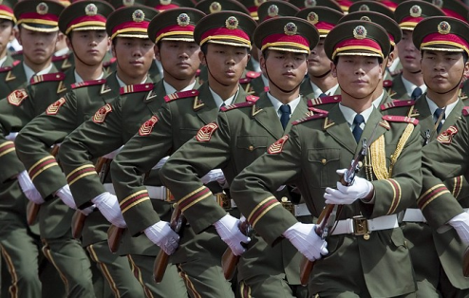
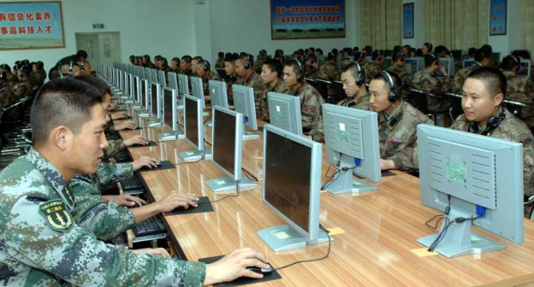
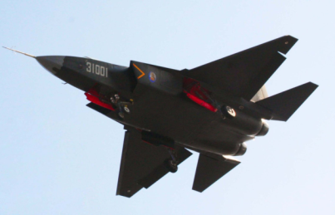
Military Estimate
Source: http://beforeitsnews.com/china/2013/03/chinese-military-leaders-calls-for-war-readiness-in-parliament-2445728.html
Source: http://www.wnyc.org/shows/bl/2013/feb/19/chinese-army-tied-hacking-against-us/
Source: http://chinesemilitaryreview.blogspot.com/2013/02/chinese-f-60j31-shen-fei-falcon-eagle.html

Slide 37
Military Facts
Current Defense Budget
$ 118 billion (based on official figures)
1.38% (based on estimated 2013 GDP)
2006 Defense Budget
$ 35 billion (based on official figures)
Approx. 3.4% of GDP
More than a 300% increase in defense spending
Notes:
Fisher Jr., R. D. (2012). Rising Dragon. Aviation Week & Space Technology, 174(47), 61.
GDP statistics - countries compared worldwide - NationMaster. (n.d.).NationMaster - World Statistics, Country Comparisons. Retrieved March 16, 2013, from http://www.nationmaster.com/graph/eco_gdp-economy-gdp&date=2006
Central Intelligence Agency. (2013, February 14). Retrieved March 16, 2013, from The World Factbook: https://www.cia.gov/library/publications/the-world-factbook/geos/ch.html
Military Spending. (n.d.).GlobalSecurity.org - Reliable Security Information. Retrieved March 17, 2013, from http://www.globalsecurity.org/military/wo

Slide 38
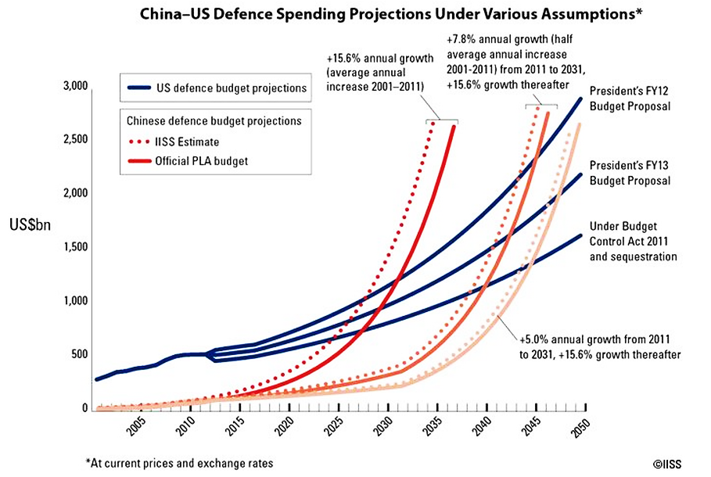
Source: http://www.defenseindustrydaily.com/china-military-spending-projections-010980/
Notes:
What is interesting about this graph is that it projects China’s defense spending surpassing the United States’ as early as 2025. You will notice a dotted line following each red line for China’s defense spending. This line is based on the common belief that China may not accurately report its spending / budget numbers. Many researchers believe China’s defense spending is far greater than actually reported.
Graph source:
Defense Industry Daily staff. (2013, March 15). Bold Projections Taken Out of Context Overstate China’s Leeway for Military Budget Growth. Retrieved from Defense Industry Daily: http://www.defenseindustrydaily.com/china-military-spending-projections-010980/

Slide 39
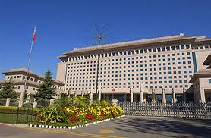
National Command and Control
Central Military Commission (CMC)
The highest level military organization with which the Chinese Communist Party (CCP) leads the armed forces
Leads the People’s Liberation Army (PLA), People’s Armed Police (PAP), and military reserve forces
Source: http://rijock.blogspot.com/2012/07/china-to-post-military-garrison-in.html
Ministry of National Defense
Created to give appearance that the state is involved in military affairs but has no staff or premises
Defense Minister is member of CMC and is a public relations facade
Notes:
http://www.sinodefence.com/overview/organisation/cmc.asp
http://www.sinodefence.com/overview/organisation/mnd.asp

Slide 40
Four General Headquarters
PLA General Staff Department (GSD)
Military Department of the CMC
Command Headquarters of the PLA
War Planning, operations, intelligence recruitment, mobilization, and training
Ground Forces, Navy and Air force
Ranks first among the four General Headquarters
PLA General Logistics Department
Logistics headquarters of the PLA and serves logistics role for the CMC
Went to Joint Logistics in 2003 to support all three service branches
Ranks third among the four General Headquarters
PLA General Political Department
Political Department of the CMC
Leads party and political matters
Manages PLA Military Court and PLA Military Procuratorate
Manages media, cultural, sport, and recreational organization
Ranks second among the four General Headquarters
PLA General Armament Department
Responsible for policy making
Supervises weapon system design, development, production, procurement, maintenance, and life-cycle management across all services
Manages the nation’s space and nuclear weapons programs
Ranks fourth among the four General Headquarters

Slide 41
Military Facts
Military Branches:
Peoples Liberation Army (PLA)
Ground Forces
Navy (incl. marines and naval aviation)
Air Force (Zhongguo Renmin Jiefangjun Kongjun, PLAAF; incl. Airborne Forces)
Second Artillery Corps (strategic missile force)
People’s Armed Police (PAP)
PLA Reserve Force
Notes:
Central Intelligence Agency. (2013, February 14). Retrieved March 16, 2013, from The World Factbook: https://www.cia.gov/library/publications/the-world-factbook/geos/ch.html

Slide 42
Military Facts
Manpower available for military service
males age 16-49: 385,821,101
females age 16-49: 363,789,674 (2010 est.)
Manpower fit for military service
males age 16-49: 318,265,016
females age 16-49: 300,323,611 (2010 est.)
Manpower reaching militarily significant age annually
male: 10,406,544
female: 9,131,990 (2010 est.)
Notes:
Central Intelligence Agency. (2013, February 14). Retrieved March 16, 2013, from The World Factbook: https://www.cia.gov/library/publications/the-world-factbook/geos/ch.html

Slide 43
Notes:
Central Intelligence Agency. (2013, February 14). Retrieved March 16, 2013, from The World Factbook: https://www.cia.gov/library/publications/the-world-factbook/geos/ch.html

Slide 44
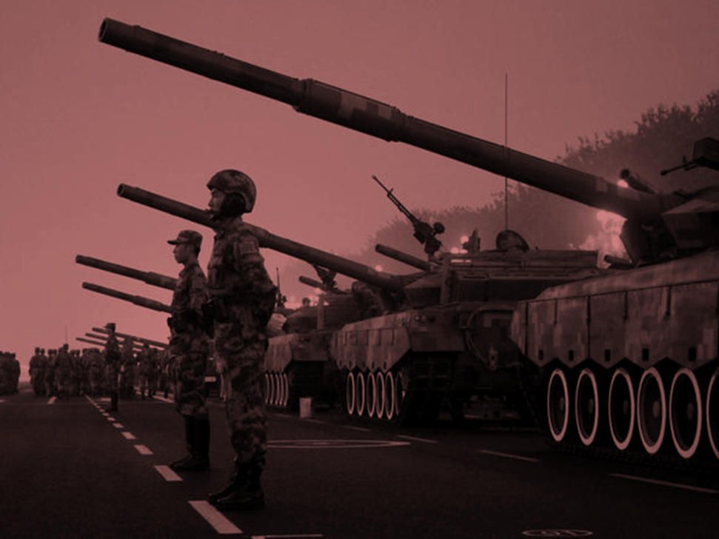
People’s Liberation Army Regular Army
Moving towards smaller, combined forces that can deploy rapidly since the mid-1980’s
Achieved mechanization and network centric warfare in the early 21st Century
1.6 million soldiers
Strength
Group Army: 18
Infantry Division: 25
Infantry Brigade: 33
Armored Division: 9
Armored Brigade: 9
Artillery Division: 3
Artillery Brigade: 15
Helicopter Regiment: 10
Source: http://online.wsj.com/article/SB125605527932596783.html
Equipment
Main Battle Tank: 7,500
IFV: 2,000
APC: 5,500
Artillery Pieces: >20,000
Helicopter: 400

Slide 45
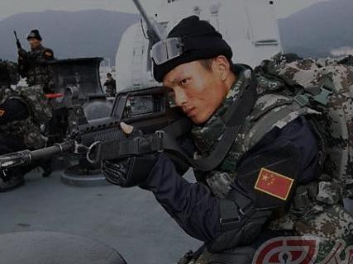
People’s Liberation Army Special Operations Forces (SOF)-Army
One SOF unit assigned to each of the seven military regions
Three missions
Direct Action
Special Reconnaissance
Counterterrorism
Typically commanded by an Intelligence Department at the military region level but sometimes at the Group Army level
Kinetically focused, no specialization in unconventional warfare or civil affairs
Source: http://sofrep.com/10144/chinese-special-operations-forces/

Slide 46
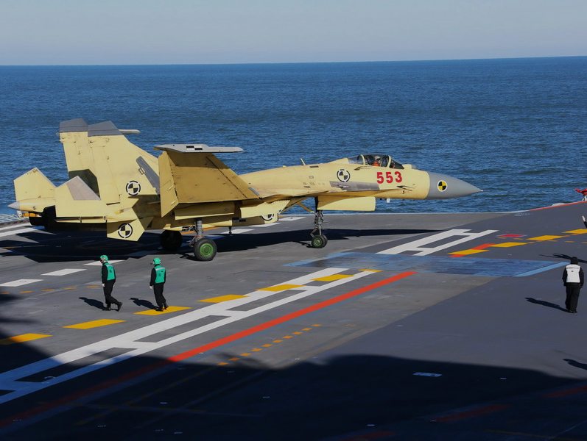
People’s Liberation Army Navy (PLAN)
Modernization since the 1980’s driven by possible military conflict with Taiwan and the need to protect sea lines of communication
-Three phase development strategy
Operate within first island chain (Japan, Taiwan, Philippines)
Operate within second island chain (Guam, Indonesia, Australia)
Global naval force by mid-21st Century
Can be supported by merchant naval fleet in times of crisis
Force size: 255,000 (10,000 Marines)
Single aircraft carrier added in 2012
Source: http://weapons.technology.youngester.com/2012/11/chinese-j-15-operation-on-aircraft.html
Major Naval Bases
Lushun
Qingdao
Shanghai (Wusong)
Zhoushan
Fuzhou
Xiamen
Guangzhou
Zhanjiang
Yulin
Surface Force
Destroyer: 26
Frigate: 49
Large landing Ship: 27
Medium landing Ship: 31
Fast attack craft: 200+
Marine Corps
Manpower: 10,000
Submarine Force
SSBN: 3
SSN: 5~7
SSK: 56
Naval Aviation
Manpower: 26,000
Aircraft: 400~500

Slide 47
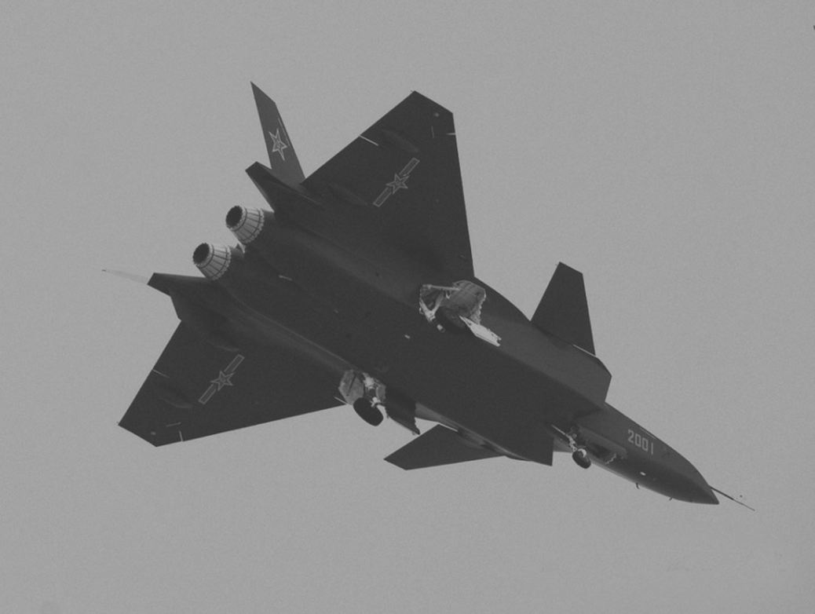
People’s Liberation Army Air Force (PLAAF)
Modernization over the last 15 years has resulted in decreased size however, increased technology and transition from defense only to offensive strike capable
Current Efforts
Procuring transport aircraft to increase airlift capabilities which = power projection
Procuring combat support aircraft (tankers, AWACS, electronic warfare, intelligence collection)
Strength: 400,000
Source: http://theboresight.blogspot.com/2011/01/chinas-j-20-enters-stealth-fray.html
Aircraft
Bomber/attack: 600
Fighter: 1,300
AWACS: 4
Large transport: 80
Tanker: 10
Special mission: 30
Surface-to-Air Missile Manpower: 210,000
SAM launcher: 500
AA gun: 16,000
Airborne Force Manpower: 24,000

Slide 48
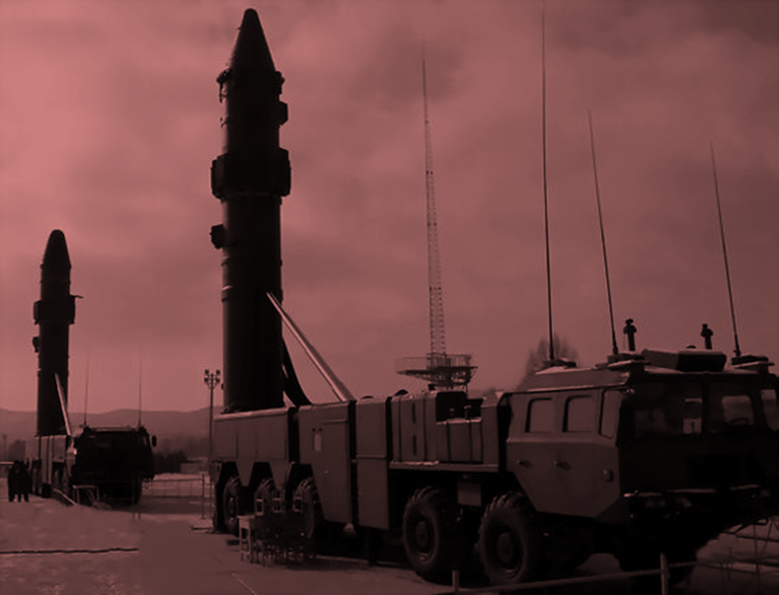
Second Artillery Corps
Strategic (independent) missile branch of PLA
Land based ballistic and cruise missile force
38 operational missile units in six bases countrywide
90,000 – 120,000 personnel
Majority of force focused on mobile short and theater/medium range
At least eight facilities support intercontinental ballistic missiles (ICBM)
Includes engineering and training support
Source: http://www.wired.com/dangerroom/2012/03/killing-chinas-carrier-killer/

Slide 49
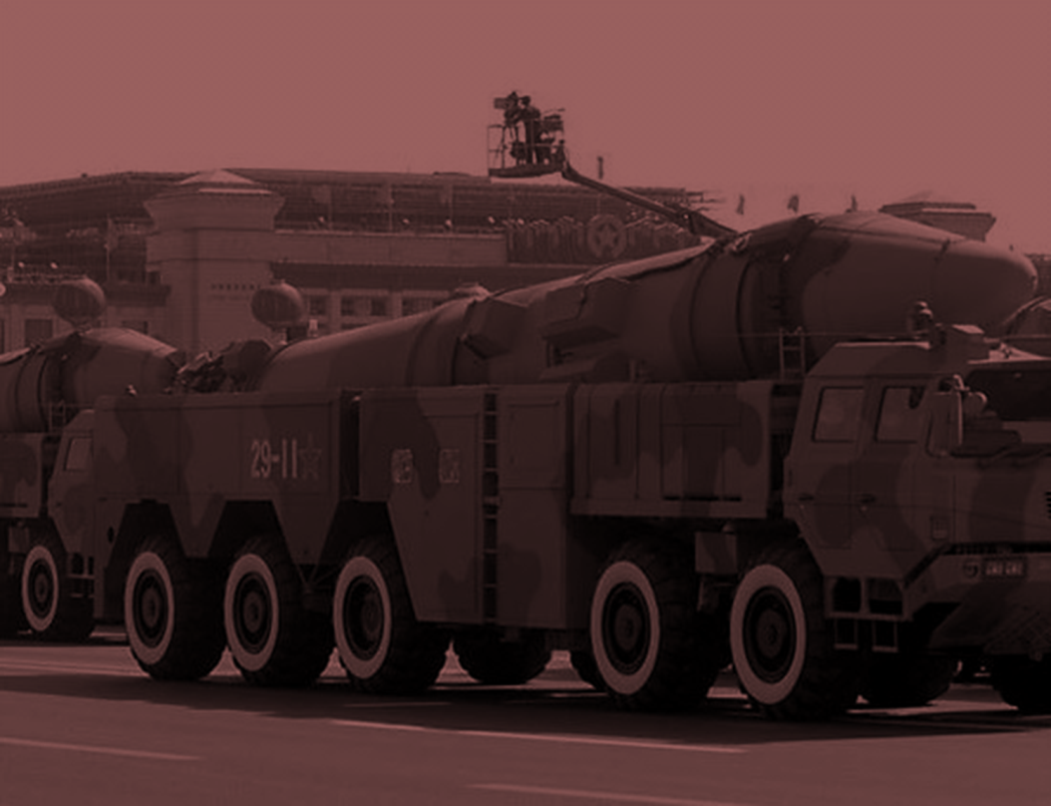
Second Artillery Corps
Nuclear retaliation campaign (he fanji zhanyi; 核反击战役)
Central control
No first use policy
Dispersed deployment
Critical needs
Conventional missile attack campaigns (changgui daodan tuji zhanyi; 常规导弹
突击战役)
Source: http://www.chinesedefence.com/china-unveils-dong-feng-21d-world%E2%80%99s-anti-ship-ballistic-missile-272/

Slide 50
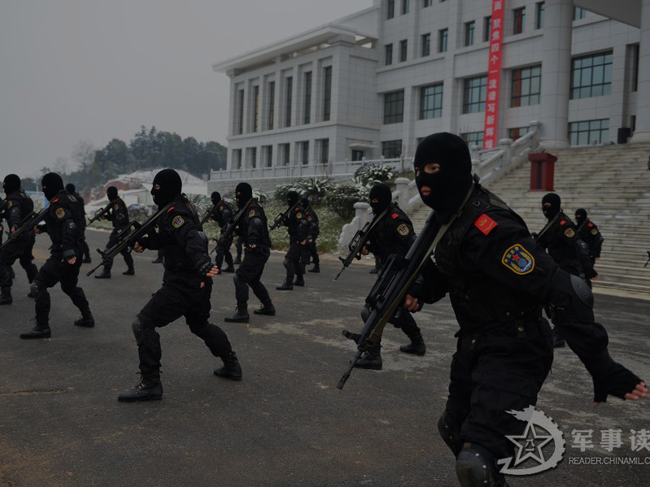
People’s Armed Police (PAP)
~ 1 million personnel
Internal Security / Paramilitary Police
Immediate Action Unit (counterterrorism)
Snow Wolf Commando Unit (counterterrorism and bomb SWAT teams)
Special Police Units (SWAT teams / training)
Border Control
Traffic Police / Firefighters
Source: http://stardefense.blogspot.com/2013/01/chinese-peoples-armed-police-force-apf.html
Notes:
PAP answers to the CMC and State Council through the Ministry of Public Security. It is not however part of the PLA. During wartime PAP concerns itself with battlefield security, anti-infiltration and coast guard (similar to the U.S.’ Naval Criminal Investigative Service or Air Force Office of Special Investigations).
http://www.globalsecurity.org/intell/world/china/pap.htm
http://www.nytimes.com/2009/08/28/world/asia/28china.html?_r=0

Slide 51
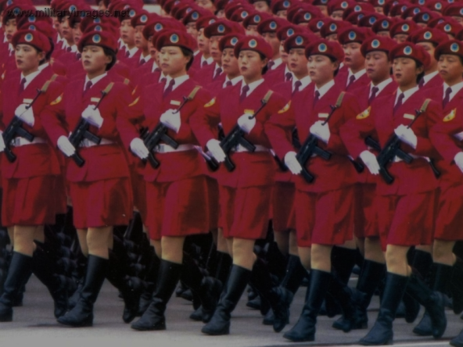
PLA Reserve Forces
Consists of reserve soldiers (including militia), demobilized soldiers, specialized technical personnel
Provides military training for senior middle-school, college, and university students (like U.S. ROTC)
Led by-
Provincial military districts or garrison commands (peacetime)
Active units or runs independently (wartime)
Source: http://thecomingcrisis.blogspot.com/2011/06/china-military-paper-urges-steps.html
Notes:
http://www.globalsecurity.org/military/world/china/pla-reserve.htm

Slide 52
Key Judgments
China’s desire to modernize its military will increase its need to steal technology from other modern militaries, to include the U.S.
Will likely occur through cyber intrusions on U.S. government and cleared defense industry
Shifting to offensive focus
Notes:
http://www.defense.gov/pubs/pdfs/2012_CMPR_Final.pdf

Slide 53
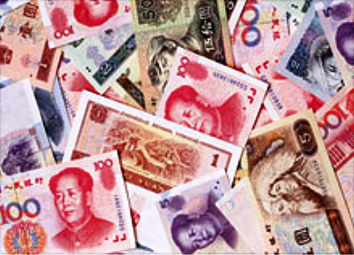
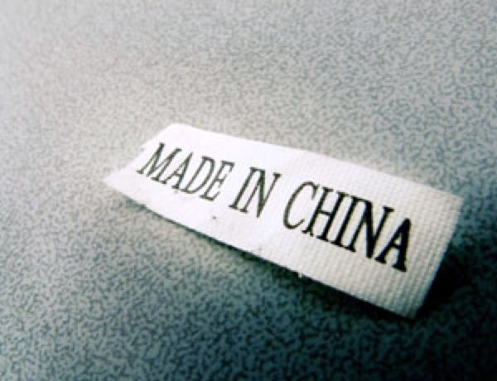
Chinese Economy
Source: http://inphobe.blogspot.com/2009_07_01_archive.html
Source: http://warnewsupdates.blogspot.com/2011/11/is-chinas-economy-going-bust.html

Slide 54
History of Chinese Economy Facts
1911 Revolution – 1937 Sino-Japanese War
steep industrial growth/cotton-wheat demand/transportation grows rural marketing/experiments in farm lending/increased wages for skilled trades and farm workers/results in increased productivity
People’s Republic of China
government established/onset of rapid inflation/budget deficit/little retention of bank deposits or currency/future plans ascertained through USSR alliance/no trust in private enterprise or international market by governing power

Slide 55
PRC Economic Future Plan Facts
Resources
industries concentrated/ increased domestic capacity/expanded industrial investment
Soviet model
“machines to produce machines” -key goal
Industrial pursuit
expense to rural policy-expendable
Plan requirements
Exponential expansion of:
Steel
Electricity
Mining
Machine-building
Education
Research

Slide 56
Mao Zedong’s Lead Facts
1958 Policy Shift
“Great Leap Forward”
Collectivization
Farmland, tools, livestock, and rural labor absorbed into “People’s Communes”
Intent/raised production/grain and steel
Huge negative impact
Disrupted admin routines
Work incentive ruined
Triggered man-made famine/ 30 million lives lost
USSR pull-out/projects crippled
1966 Cultural Revolution
Many schools and colleges were closed
Remaining schools abandoned normal standards for up to ten years
Accomplishments
Economic growth
Industrialization
Technology
Nuclear weapons
Space exploration
Human development-
reduced infant mortality
increased literacy
disease control

Slide 57
PRC Business Cycle
Economic Reform
Household farming popular
Four Special Economic Zones on southern coast opened a portion of Chinese economy to international trade and investment
Regional government owned business retained small share of profits to build state assets
Retained profits revived some markets for industrial products
Reform Impacts
Resulted in massive increase in agricultural output
Raised farm incomes, improved quality of life, and increased rural productivity
Food exports increased and import decreased
Grain
Cotton
Sugar
Fruit
Launched explosive boom in rural industry

Slide 58
China’s 12th Five Year Plan (2011-2015)
The 12th FYP (2011-2015) contains three broad themes or areas of focus
Economic restructuring
Promoting greater social equality
Protecting the environment
Chinese industrial policy comes into play primarily in economic restructuring but also is apparent in the other areas of focus. Particularly noteworthy is the targeting of seven strategic emerging industries that are intended to become the backbone of China’s economy in the future and to be able to compete well on a global scale.
Seven industries
Biotechnology
New energy
High-end equipment manufacturing
Energy conservation and environmental protection
Clean-energy vehicles
New materials
Next-generation information technology

Slide 59
China’s 12th Five Year Plan (2011-2015)
The government reportedly intends to spend up to $2.1 trillion on these industries during the 12 Th FYP. Some of the highlights of the FYP include: achieving an average real GDP growth rate of 7% and ensuring that incomes rise at least as fast as GDP
Consolidating inefficient sectors and promoting the services industry (with the goal of expanding service sector output to account for 47% of GDP—up four percentage points from the current level)
Promoting energy saving and new energy industries; promoting the development of nuclear, water, wind, and solar power; and expanding non-fossil fuel to account for 11.4% of primary energy consumption
Welcoming foreign investment in modern agriculture, high-technology, and environmental protection industries
Turning coastal regions from “world’s factory” to hubs of research and development, high-end manufacturing, and services
Lengthening high-speed railway and highway networks
Increasing expenditure on R&D to account for 2.2% of GDP
Expanding non-fossil fuel or refining to account for 11.4% of primary energy consumption
Cutting water consumption per unit of value-added industrial output by 30%, energy consumption per unit of GDP by 16%, and carbon dioxide emission per unit of GDP by 17%
Increasing the minimum wage by no less than 13% on average each year
Building 36 million affordable apartments for low-income people

Slide 60
Measuring an Economy
Many economists contend that using nominal exchange rates to convert Chinese data into U.S. dollars fails to reflect the true size of China’s economy and living standards relative to the U.S.
To combat this, estimates of exchange rates based on their actual purchasing power relative to the dollar are developed in order to make more accurate comparisons of economic data across countries, usually referred to as purchasing power parity (PPP)
Using this method, the PPP exchange rate increases the estimated measurement of China’s economy and its per capita GDP

Slide 61
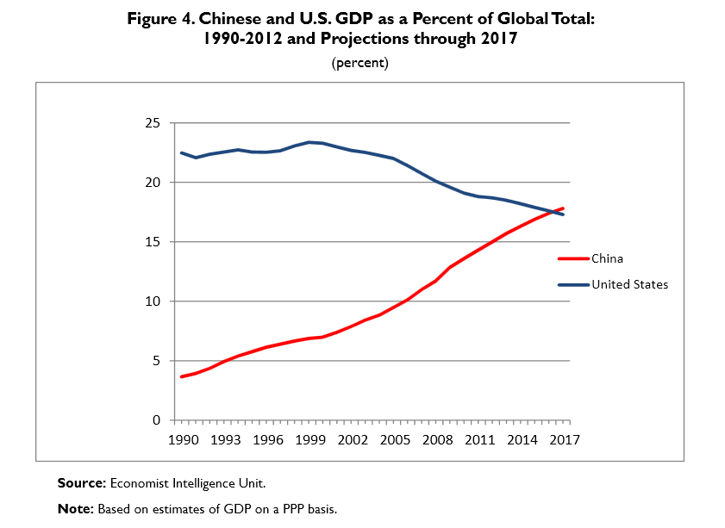
Current and Projected Economic Growth
Economists predict that on a PPP basis China will overtake the U.S. as the world’s largest economy by 2017
Further predictions put China’s economy at 24.1% larger than that of the United States by 2030
Source: http://www.fas.org/sgp/crs/row/RL33534.pdf

Slide 62
China at a Glance
Population – 1,344,130,000
GDP - $7,318,499,269,769
GDP growth– 9.2%
Inflation 5.4%

Slide 63
Applying the PPP to China’s Economy
China’s GDP in 2012 was $8.2 Trillion – about two-thirds the size of the U.S. economy
The per capita GDP of China was $6,190 – 12% that of the U.S.
Applying the PPP raises China’s 2012 GDP from $8.2 Trillion to 12.6 Trillion
This calculation indicates that China’s economy is 80% the size of that of the U.S.
China’s share of the global GDP on a PPP basis rose from 3.7% in 1990 to 15% in 2012
The PPP measurement also raises China’s 2012 per capita GDP from $6,190 to $9,460 which is 18.9% of the U.S. level

Slide 64
China’s Current World Economic Influence
Second largest economy
Largest merchandise exporter
Second largest merchandise importer
Second largest destination of foreign direct investment (FDI)
Largest manufacturer
Largest holder of foreign exchange reserves
Largest creditor nation

Slide 65
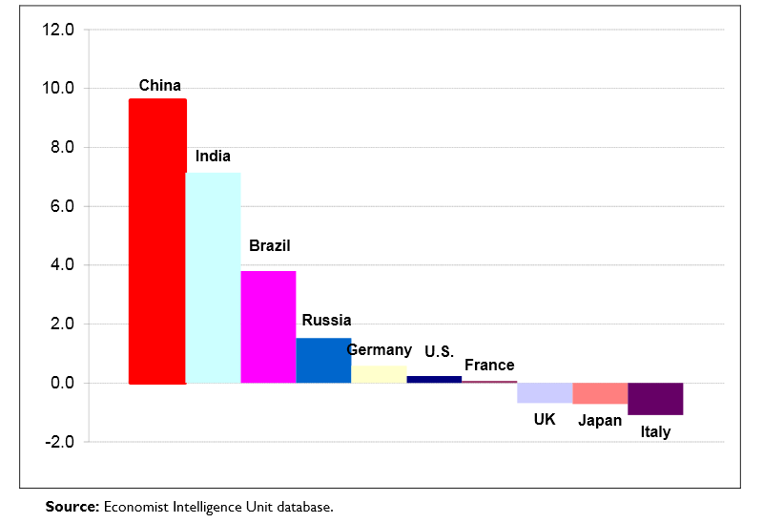
Chinese average real GDP growth among major global economies: 2008-2011
Source: China’s Economic Rise: History, Trends, Challenges, and Implications for the United States (March 4, 2013)
http://www.fas.org/sgp/crs/row/RL33534.pdf

Slide 66
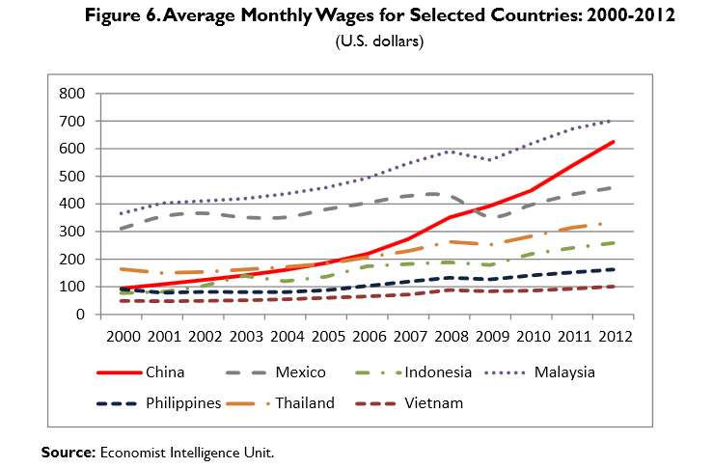
Chinese Labor Costs
China’s average real wages have been on the rise from 2000 to 2012 at an average annual rate of 11.8%
Source: China’s Economic Rise: History, Trends, Challenges, and Implications for the United States (March 4, 2013)
http://www.fas.org/sgp/crs/row/RL33534.pdf

Slide 67
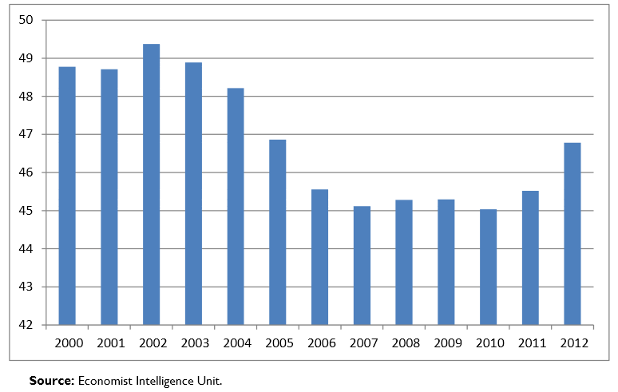
Income Distribution
Chinese Disposable Income as a Percent of GDP: 2000-2012
In spite of increases in wages and disposable income, frustrations are growing that many citizens are not benefiting from China’s rapid growth.
“A 2005 United Nations report stated that the income gap between the urban an rural areas was among the highest in the world and warned that this gap threatens social stability… The report urged China to take greater steps to improve conditions for the rural poor, and bolster education, health care, and the social safety net”
Source: China’s Economic Rise: History, Trends, Challenges, and Implications for the United States (March 4, 2013) http://www.fas.org/sgp/crs/row/RL33534.pdf

Slide 68
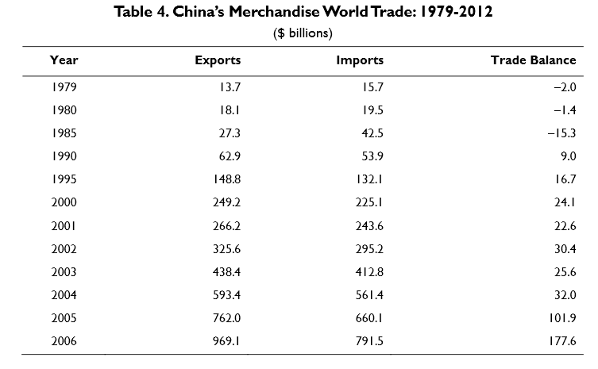
China’s World Trade
Impact of Globalization
“In 2012, China overtook the United States as the world’s largest trading economy… Merchandise trade surpluses, large scale foreign investment, and large purchases of currencies to maintain its exchange rate with the dollar and other currencies have enabled China to become the world’s largest holder of foreign exchange reserves at $3.31 trillion at the end of 2012”
Source: China’s Economic Rise: History, Trends, Challenges, and Implications for the United States (March 4, 2013)
http://www.fas.org/sgp/crs/row/RL33534.pdf

Slide 69
Impacts of Technological Change to Economy
Rare element monopoly
Necessity to refine economic policy
Long term challenges
Industry
Banking system
Undervalued currency

Slide 70
China’s Monopoly of Rare Earth Elements (REE)
“Rare earth elements (REE) are essential to civilian and military technologies and to the 21st century global economy, including development of green technologies and advanced defense systems”
China has a monopoly over 95% of mined production and refining
July 2010 export cut imposed by China drove prices to a peak in mid-2011
“As of December 2012, REE prices had receded but still remained at least 80%, and as much as 600 % (depending on the type of REE) above pre-July 2010 levels”

Slide 71
Devotion to Defense
Contributions to defense match GDP
Aging demographic and urbanization will repurpose funds for health care, pensions, public infrastructure, and environment
Even in global economic downturn defense spending saw no decrease

Slide 72
Long-Term Challenges: Industry
Incomplete transition to a market economy and persisting government identification as a “socialist market economy”
State owned business continue to dominate petroleum and mining, telecommunications, utilities, transportation, and other industrial sectors
State owned businesses are shielded from competition, are the main sectors encouraged to invest overseas, and dominate the Chinese stock indexes
“Of the 58 Chinese firms on the 2011 Fortune Global 500 list, 54 were identified as having government ownership of 50% or more”
“The World Bank estimates that more than one in four SOE’s lose money”

Slide 73
Long-Term Challenges: China’s Banking System
Banking system and credit controlled by central government
Credit is extended to government favored industries who receive preferential treatment and rates
Private entities pay higher rates or obtain credit elsewhere
Government set depositor interest rates are often below the rate of inflation which lowers household income
State owned business loans are often not repaid leaving large numbers of non-performing loans
Local governments believed to have borrowed extensively from state banks at the onset of the global economic slowdown which may increase non performing loans

Slide 74
Long-Term Challenges: Undervalued Currency
Government imposed exchange rates prevent currency values from floating beyond prescribed margins
Results in large-scale purchases of money to preserve the exchange rate
Undervaluing of Chinese currency makes exports less expensive and imports more expensive
Policies have limited growth of the private sector and distorted markets by artificially lowering costs of capital, water, land, and energy below market levels

Slide 75
Economic Judgments
Slowing Chinese economy/neglectful of funds flowing to defense spending
Continued favoritism for preferred industries will slow growth of market economy
Private ventures continue to struggle/Chinese government concentrated on SOE’s
Non-performing loans by state owned entities will continue to draw state bank funds down
Dependence on exports and fixed investing debilitating for future of economy
Internal currency value manipulation is dependent on viability of purchased monetary values – significant change in foreign currency rates draw Chinese currency value and availability down
Chinese political structure will carry on with improper reporting of currency valuation

Slide 76
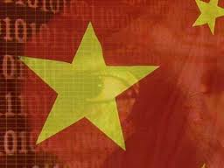
Chinese Cyber
Source: http://www.tigerstartups.com/blogs/358/avoiding-a-cyber-cold-war-china-and-us-to-work-together-on-cyber-security

Slide 77
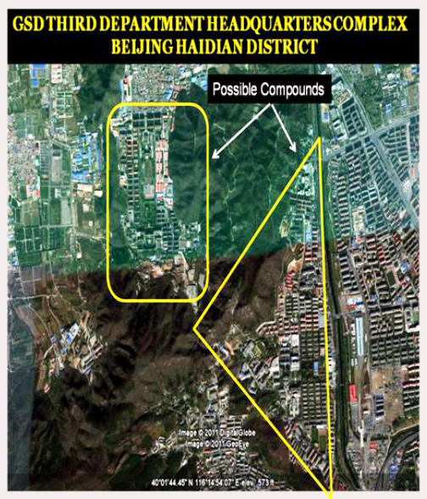
GSD 3rd Department – Location General Staff Department
China’s PLA manages a vast communications intercept infrastructure and cyber surveillance system in Beijing’s Haidian District. Figure 1 shows an aerial photo of possible compounds.
Unconfirmed reports indicate that the GSD 3rd Department staffs around 130,000 personnel distributed throughout general headquarters staff positions, the 12 operational bureaus, and three research institutions.
Source: http://project2049.net/documents/pla_third_department_sigint_cyber_stokes_lin_hsiao.pdf
Notes:
Hsiao, R., Lin, J., & Stokes, M. (November 11, 2011). The chinese people’s liberation army signals and cyber reconnaissance infrastructure. Retrieved from http://project2049.net/documents/pla_third_department_sigint_cyber_stokes_lin_hsiao.pdf

Slide 78
GSD 3rd Department Research Institutes
56th Research Institute
Also known as the Jiangnan Computer Technology Research Institute, the 56th Research Institute is the PLA’s oldest computing research and development organization/ specializes in high performance computing.
57th Research Institute
The 57th Research Institute is responsible for developing communication interception and signal processing systems
58th Research Institute
The primary focus of the 58th Research Institute is in the arena of cryptology and information security technology
Notes:
(Hsiao, Lin, & Stokes, 2011)

Slide 79
GSD 3rd Departments – Bureaus
First Bureau (Unit 61786) – The First Bureau’s mission includes decryption, encryption, and other information security tasks
Second Bureau (Unit 61398) – The Second Bureau is the PLA’s primary entity that targets the United States and Canada
Third Bureau (Unit 61785) – The Third Bureau’s responsibility appears to be in the collection of line of sight radio transmissions, including border control networks, direction finding, and emission control, and security
Fourth Bureau (Unit 61419) – Where the Second Bureau is focused on the U.S. and Canada, the Fourth Bureau seems to be focused on Japan and Korea
Fifth Bureau (Unit 61565) – The Fifth Bureau appears to perform Russian based missions
Sixth Bureau (Unit 61726) – The Sixth Bureau serves as a political commissar and possibly as a training unit
Seventh Bureau (Unit 61580) – The duties of the Seventh Bureau are unclear. Per reports, bureau engineers have conducted joint research with the PLA Information Engineering Academy Computer Network and Defense section
Eighth Bureau (Unit 61046) – The Eighth Bureau has a large concentration of linguistic experts, lending to the the assumption that their mission is communication based
Ninth Bureau – The Ninth Bureau seems to be the primary strategic intelligence analysis and/or database management entity
10th Bureau (Unit 61886) – Sometimes referred to as Unit 7911, the 10th Bureau has a focus on Central-Asia and Russian based missions
11th Bureau (Unit 61672) – Also known as Unit 2020, the 11th Bureau employs Russian linguists and its location indicates that its primary missions are Russian based
12th Bureau (Unit 61486) – The most likely mission for the 12th Bureau appears to be satellite related, probably specializing in transmission interception and possibly space based SIGINT collection
Notes:
(Hsiao, Lin, & Stokes, 2011)

Slide 80
GSD 3rd Department Personnel Training
Generally, personnel are trained in two locations.
Language based training is performed at the PLA University of Foreign Languages. After graduating, personnel are assigned to a bureau for mission specific technical training.
Training for technical personnel, which includes electrical engineers, communications specialists, computer scientists, and network security specialists are sent to the PLA Information Engineering University.
Notes:
(Hsiao, Lin, & Stokes, 2011)

Slide 81
PLA GSD 3rd Department 2nd Bureau (Unit 61398)
Unit 61398’s central building is a 12 story 130k sq ft building built in 2007
China Telecom provided special fiber optic infrastructure citing “national defense”
Unit 61398 requires personnel trained in computer security and networking
Also requires English language proficiency

Slide 82
Cyber Espionage Tasking
Chinese Communist Party(CCP) is tasking the PLA to commit cyber espionage worldwide
Unit 61398 tasked with computer network operations
Unit 61398 appears to be the primary group for targeting political, economic and military-related intelligence in the U.S. and Canada

Slide 83
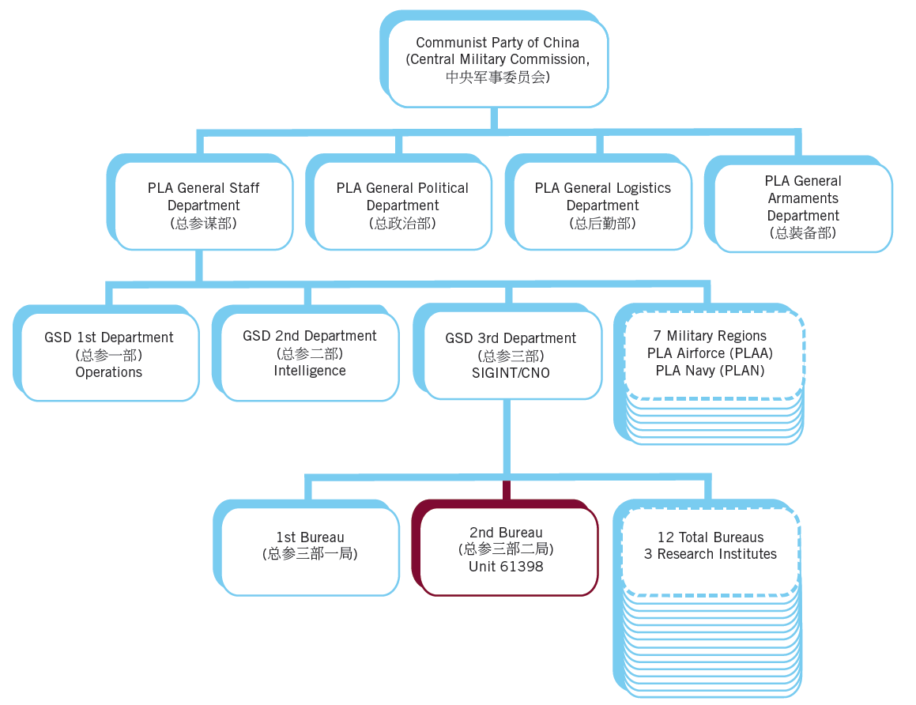
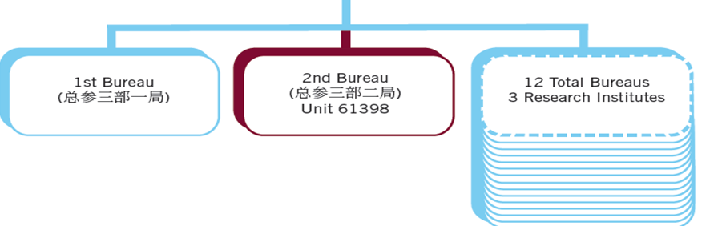
Unit 61398 Subordination
Source: http://intelreport.mandiant.com/

Slide 84
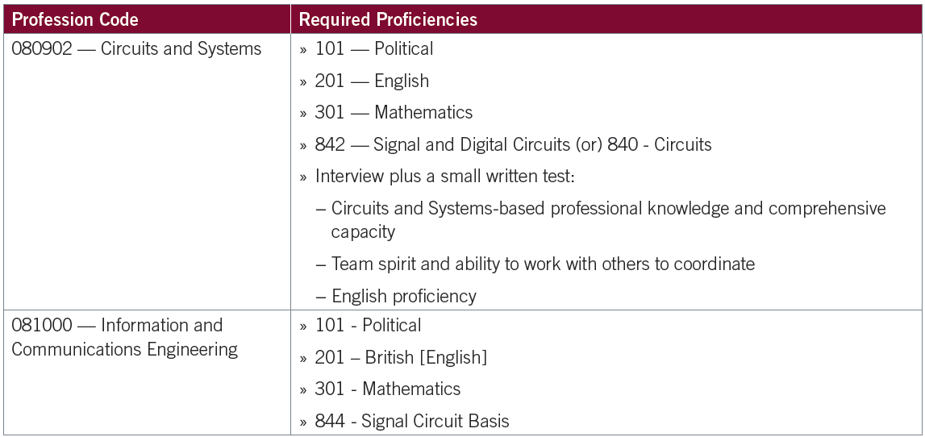
Unit 61398 Skill Requirements
Source: http://intelreport.mandiant.com/

Slide 85
Cyber Espionage Groups
More than 20 such groups operating from China
Studied since 2006, APT1 has been one of the most prolific in terms of quantity of data stolen
APT1 is probably Unit 61398
Notes:
Perera, D. (December 6, 2010). Chinese attacks ‘bizantine candor’ penetrated federal agencies, says leaked cable. Retrieved from http://www.fiercegovernmentit.com/story/chinese-attacks-byzantine-candor-penetrated-federal-agencies-says-leaked-ca/2010-12-06

Slide 86
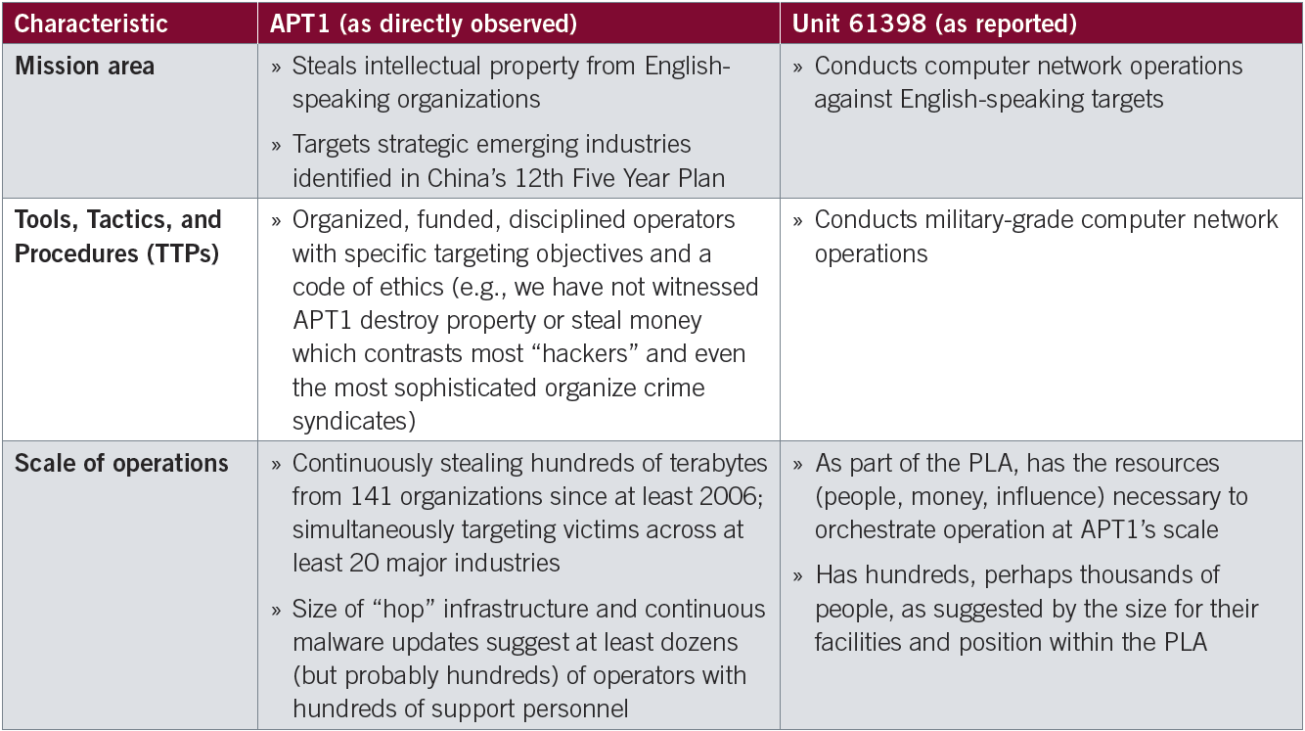
APT1 and Unit 61398 Similar Characteristics
Source: http://intelreport.mandiant.com/

Slide 87
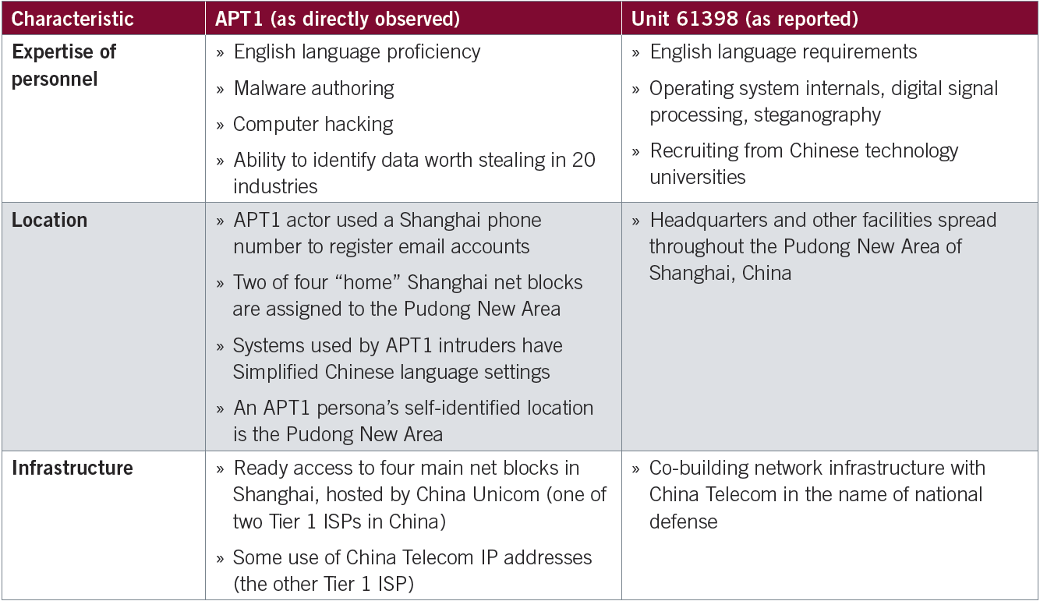
Characteristics (cont)
Source: http://intelreport.mandiant.com/

Slide 88
APT1 – Level of Effort
First detected late 2006, still active
Has targeted at least 141 organizations
Demonstrated capability to attack dozens simultaneously
Maintains access to compromised systems
Average 356 days
Longest observed over 4 years 10 months

Slide 89
APT1 – Local and Global Footprint
Maintains an extensive worldwide infrastructure
Thousands of systems
Dozens of countries
Hundreds of domain names
All attacks originate from four large networks in Shanghai
Two in Pudong New Area, home of Unit 61398

Slide 90
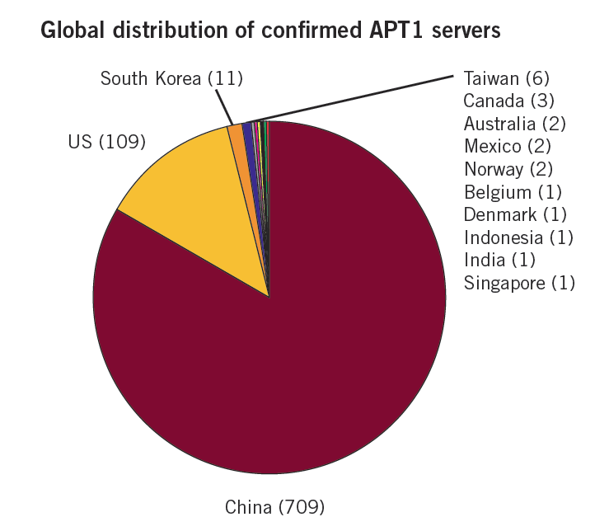
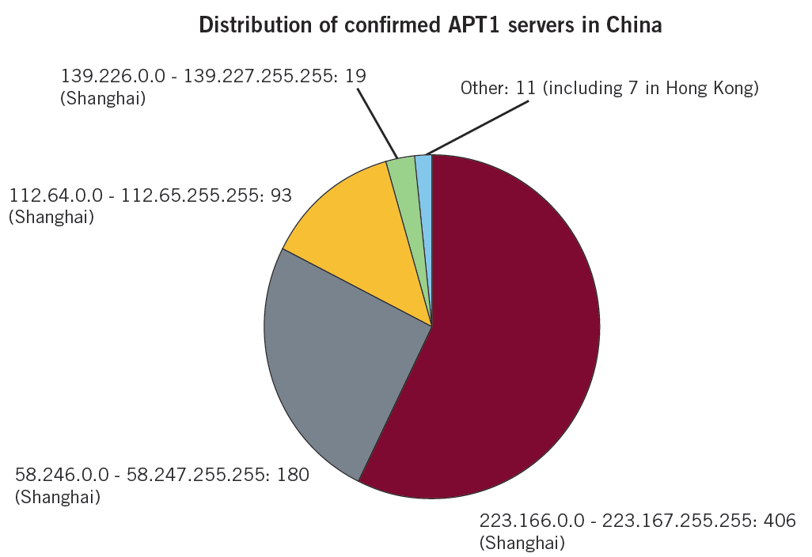
APT1 Servers
Source: http://intelreport.mandiant.com/

Slide 91
Operating Inside APT 1
APT1 Operators
Typically use remote desktop from a Shanghai IP address to access hop points on compromised systems to disguise attack origin
Typically use a “Chinese (Simplified) – US Keyboard” setting
Indicates a client language setting of simplified Chinese (zh-cn), used predominately in China
Taiwan and Hong Kong still use traditional Chinese (zh-tw)
Three APT1 Operator Profiles “isn’t it ironic”
With the level of monitoring and control conducted by China over Internet use it is necessary for the individuals conducting these operations to have less restricted access. This also means that these operators are likely to use this access for personal as well as professional activities. Consequently, they are also likely to expose themselves. Here are three examples:
Ugly Gorilla
DOTA
SuperHard

Slide 92
APT1 - Targets
Of 141 observed attacks, HQ for 122 of victims were in English speaking countries
Includes 115 U.S., 5 U.K. and 2 Canada
17 of the remaining 19 targets use English as a primary language for operations

Slide 93
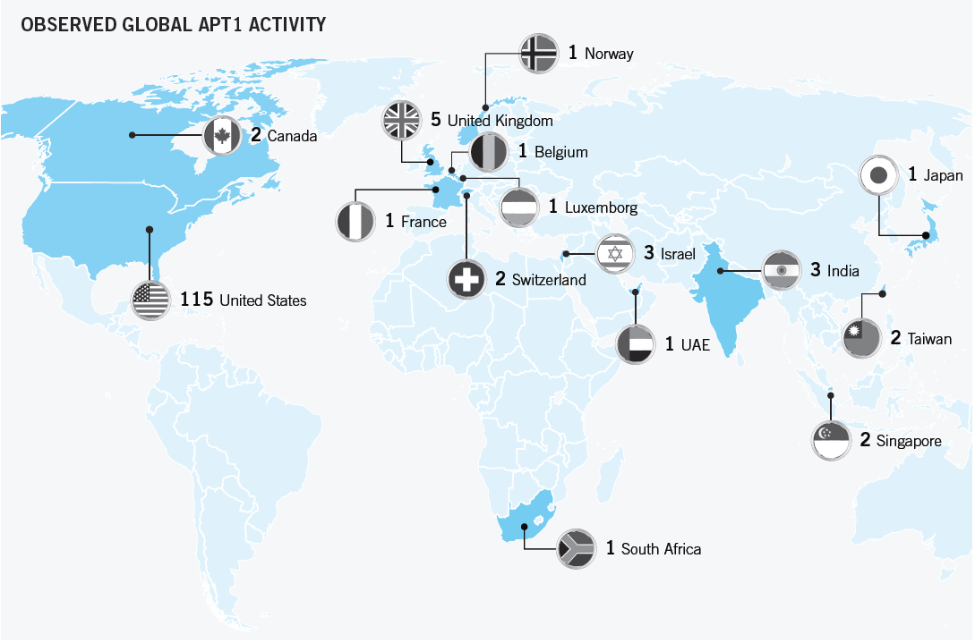
Source: http://intelreport.mandiant.com/

Slide 94
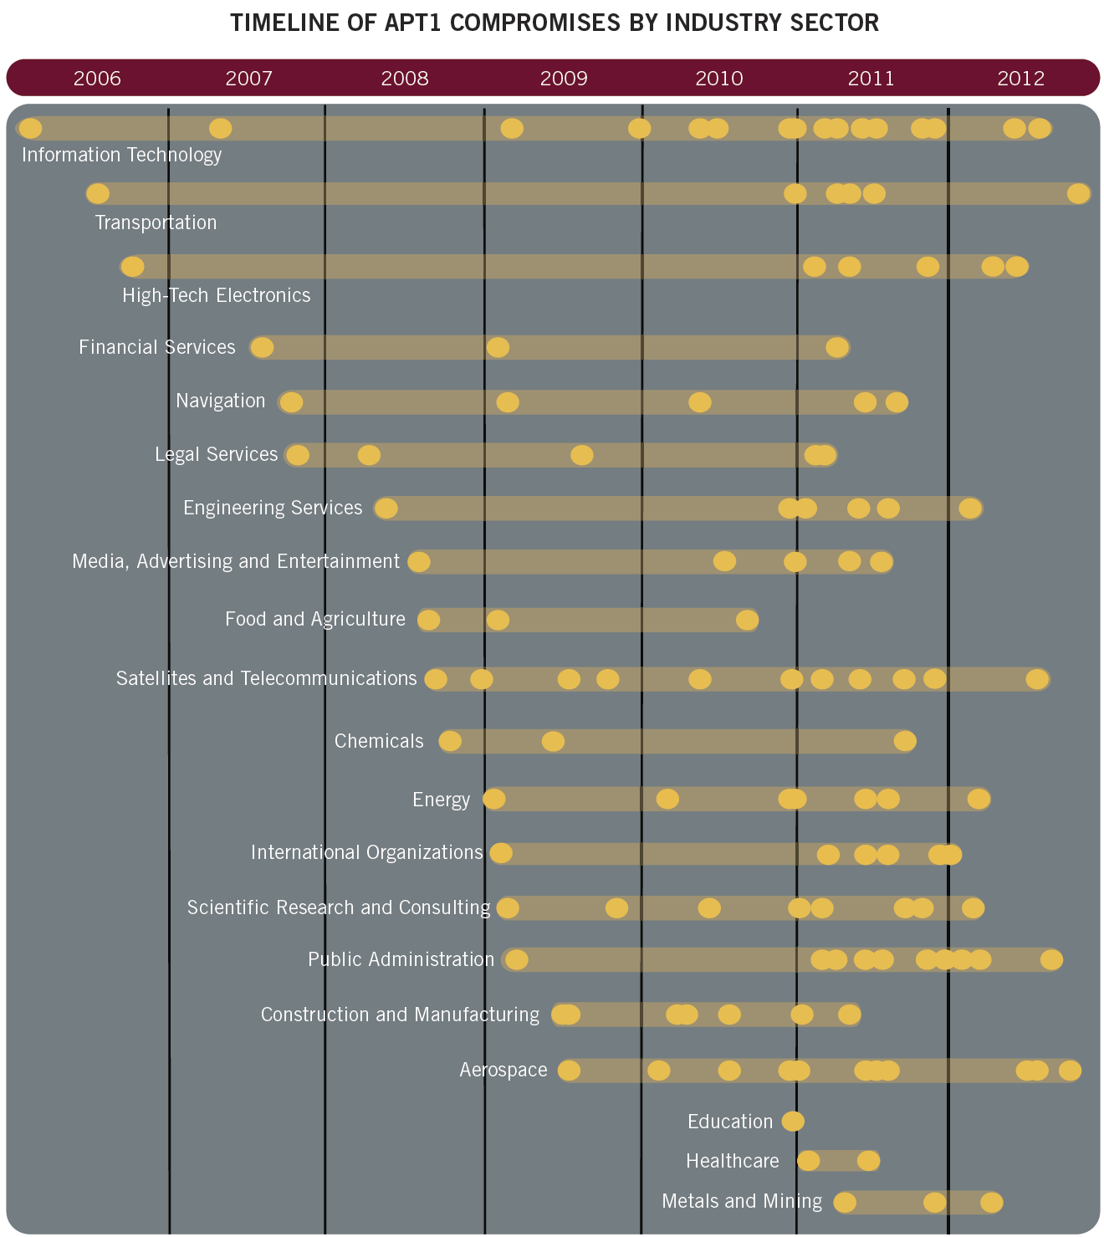
Source: http://intelreport.mandiant.com/

Slide 95
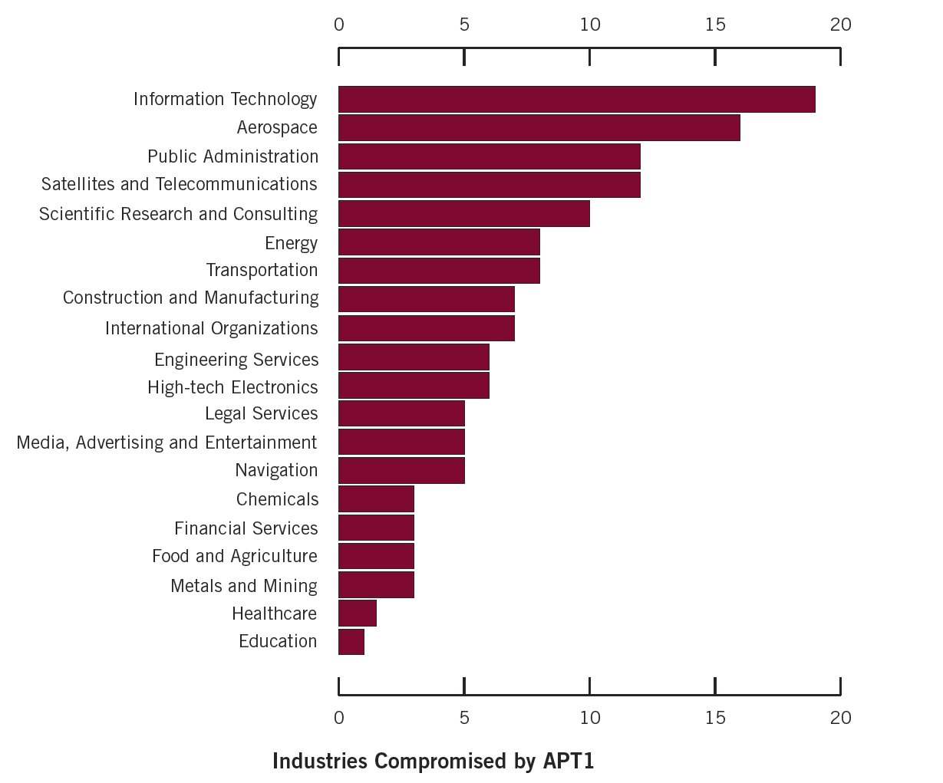
Source: http://intelreport.mandiant.com/

Slide 96
Type of Data
Broad Range of Data
Product development & use
Manufacturing procedures
Business plans
Policy positions & white papers
Emails
User credentials & network architecture info

Slide 97
Quantity of Data
Difficult to determine
They clean up as they go (deleting archives)
Time lapse between theft and investigation
In one observed case, APT1 stole approx 6.5 TB of compressed data from a single organization over a 10 month period

Slide 98
Data Use and AKA’s
Perceived Data Use
In 2008 APT1 compromised the network of a company
Tools were installed which enabled archive creation and access to emails
Maintained active access for 2 ½ years
During this time, China was able to negotiate a double-digit decrease in price per unit with the victim
APT1 AKA
Comment Crew (confirmed)
Comment Group (confirmed)
Shady Rat (possible)

Slide 99
APT1 Attack Lifecycle & Other Groups
APT1 Attack Lifecycle
Initial compromise – usually Spear Phishing
Install a backdoor
Escalate privileges
Explore the compromised network
Expand the foothold
Obtain legitimate credentials
Collect and steal data
APT1 – Not the only player Other Chinese (?) Groups
Nitro Attacks
Elderwood
Sykipot
Aurora
Night Dragon

Slide 100
China’s Blue Army
On May 25, 2011, China’s PLA spokesperson Geng Yansheng announced the existence of a cybersecurity group. The group was referred to as an “Online Blue Army” and is based in China’s southern Guangzhou military region (Beech, 2011).
At the time of the announcement, the blue army was comprised of 30 cybersecurity experts ranging from existing PLA soldiers, officers, college students and other various members of society (Lewis, 2011).
It is believed that the Blue Army has been in existence for two years prior to the announcement.
There are mixed reports on the financing available, ranging from just short of $1.5 million USD to over $10 million USD (Beech, 2011).
Notes:
Beech, H. (May 27, 2011). Meet China’s newest soldiers: an online blue arm. Retrieved from http://world.time.com/2011/05/27/meet-chinas-newest-soldiers-an-online-blue-army/

Slide 101
Social Implications of Cyber
Waning support for Communist agenda
Growing interest in materialism
Growing critical analysis and cognitive sophistication among Chinese non academia
Protests and public unrest

Slide 102
Governing Manifestations due to Cyber
Reduced internet censorship to retain public support for agenda
Required or strongly suggested educational direction in cyber and computer engineering
Massive necessity for cyber defense force
Must face environmental and human rights problems apparent via Internet

Slide 103
Cyber Judgments
Significant cyber espionage and attacks coming from China
Strong evidence of government support or active participation in these activities
Strong alignment between China’s self interest and the results of industrial cyber espionage
Absence of provable attribution or consequences, activity likely to continue

Slide 104
Countermeasure Recommendations
Mandated level of security training in hardware & software for government, SCADA, and ICS network personnel
Mandated level of security for hardware and software versions/configurations in government, SCADA, and ICS networks
Required oversight/audits/pen testing of government, SCADA, and ICS networks
Firm outline on what constitutes as a critical infrastructure (CI) network
Incentive for cybersecurity service in government, SCADA, and ICS networks
Intensive research and development for cyber offensive and defensive strategies
Constructs must be asymmetric and coordinated

Slide 105
References Primary
Carroll, B. (2010). China’s 12th Five Year Plan. APCO. Retrieved on March 20, 2013 from http://apcoworldwide.com/content/PDFs/Chinas_12th_Five-Year_Plan.pdf
Fung, E., and Peng, Y. (2012). Forces Driving China’s Economic Growth in 2012. KPMG China. Retrieved on March 21, 2013 from http://www.kpmg.com/cn/en/IssuesAndInsights/ArticlesPublications/Documents/China-12th- Five-Year-Plan-
China-Economic-Growth-201203-2.pdf
Krekel, B., Adams, P., & Bakos, G. (2012). Occupying the Information High Ground. Northrop Grumman Corp.
Lawrence, S.V., Martin, M.F.(2013). Understanding China’s Political System. (R41007) Retrieved on March 10, 2003 from
https://www.fas.org/sgp/crs/row/R41007
Li, N. (2009). Assessing the threat: The chinese military and taiwan's security. The China Journal, (62), 212-214.
Retrieved from http://search.proquest.com/docview/222740530?accountid=28902

Slide 106
References Primary
Mandiant. (2013). APT1 Exposing one of China’s cyber espionage units. Retrieved March 25, 2013, from
Mandiant website: http://intelreport.mandiant.com/
Morrison, W. (2013). China’s Economic Rise: History, Trends, Challenges, and Implications for the United States. Congressional Research Service. Retrieved on March 4, 2013 from http://www.fas.org/sgp/crs/row/RL33534.pdf
Nichols, R. (2006, April 27). Hydra. Hydra GOVSEC Protecting Critical Infrastructures Data Security. INFOSEC Technologies.
Prolexic. (2013). Prolexic quarterly global ddos attack report. Retrieved March 25, 2013, from Prolexic website: http://www.prolexic.com/gad/2012-q4- attackreport.html?pi_ad_id=19276436043&_kk=prolexic%20ddos&_kt=7e5409dd-111a-420b-b78a- 24670d1838b1&gclid=CIKCgdqnm7YCFSKpPAodpzsAzQ
Rawski, T. (June 2011). The Rise of China's Economy. Foreign Policy Research Institute Footnotes Vol. 6, No. 6. Retrieved on March 8, 2013 from http://www.fpri.org/footnote/1606.201106.rawski.chineseeconomy.html

Slide 107
References Primary
Stokes, M. A., Lin, J., & Hsiao, R. (2011). The Chinese People’s Liberation Army signals intelligence and cyber
reconnaissance infrastructure. Retrieved March 25, 2013, from
Project 2049 Institute website: http://project2049.net/documents/pla_third_department_sigint_cyber_stokes_lin_
hsiao.pdf

Slide 108
References Secondary
Beech, H. (May 27, 2011). Meet China’s newest soldiers: an online blue arm. Retrieved from http://world.time.com/2011/05/27/meet-chinas-newest-soldiers-an-online-blue-army/
China. Country Profiles. NTI. (n.d.). the Nuclear Threat Initiative. Retrieved March 28, 2013, from http://www.nti.rsvp1.com/country-profiles/china/?mgh=http%3A%2F%2Fwww.nti.org&mgf=1
Chinese Air Forces - SinoDefence.com. (n.d.). SinoDefence.com - The Chinese Military in the 21st Century. Retrieved March 28, 2013, from http://www.sinodefence.com/airforce/default.asp
Chinese Ground Forces - SinoDefence.com. (n.d.). SinoDefence.com - The Chinese Military in the 21st Century. Retrieved March 28, 2013, from http://www.sinodefence.com/army/default.asp
Chinese Military Review. (n.d.). Chinese Military Review. Retrieved March 28, 2013, from http://chinesemilitaryreview.blogspot.com/

Slide 109
References Secondary
Chinese Military Review. (n.d.). Chinese Military Review. Retrieved March 28, 2013, from http://chinesemilitaryreview.blogspot.com/
Chinese Naval Forces - SinoDefence.com. (n.d.). SinoDefence.com - The Chinese Military in the 21st Century. Retrieved March 28, 2013, from http://www.sinodefence.com/navy/default.asp
Fisher Jr., R. D. (2012). Rising Dragon. Aviation Week & Space Technology, 174(47), 61.
GDP statistics - countries compared worldwide-NationMaster. (n.d.). NationMaster -World Statistics, Country Comparisons. Retrieved March 16, 2013, from http://www.nationmaster.com/graph/eco_gdp-economy-gdp&date=2006
INPhobe. (2009, July 7). China y Brasil abandonarán el dólar para comerciar en favor de su divisa. Retrieved March 20, 2013, from http://inphobe.blogspot.com/2009/07/china-y-brasil- abandonaran-el-dolar.html

Slide 110
References Secondary
KPMG. (2013). China’s 12th Five Year Plan Insight Series. Retrieved on March 20, 2013 from http://www.kpmg.com/cn/en/issuesandinsights/articlespublications/publicationseries/5-years-plan/pages/default.aspx
Lewis, J. A. (2013). Cyber incidents attributed to China. Retrieved March 25, 2013, from Center for Strategic & International Studies website: http://csis.org/publication/cyber-incidents-attributed-china
Lewis, J. A. (2013, March 22). Five myths about Chinese hackers. The Washington Post. Retrieved March 25, 2013, from http://articles.washingtonpost.com/2013-03-22/opinions/37923854_1_chinese-hackers-cyberattacks- cold-war
Lewis, J. A. (2013). Significant cyber events. Retrieved March 25, 2013, from Center for Strategic & International Studies website: http://csis.org/publication/cyber-events-2006\

Slide 111
References Secondary
Lewis, L. (May 27, 2011). China’s blue army of 30 computer experts could deploy cyber warefare on foreign powers. Retrieved from http://www.theaustralian.com.au/australian-it/chinas-blue-army-could-conduct-cyber- warfare-on-foreign-powers/story-e6frgakx-1226064132826
Medeiros, E. (2004, February 6). Analyzing China’s Defense Industries and the Implications for Chinese Military Modernization | RAND. RAND Corporation Provides Objective Research Services and Public Policy Analysis. Retrieved March 28, 2013, from http://www.rand.org/pubs/testimonies/CT217.html
People's Armed Police - Chinese Intelligence Agencies. (n.d.). GlobalSecurity.org - Reliable Security Information. Retrieved March 28, 2013, from http://www.globalsecurity.org/intell/world/china/pap.htm
Perlroth, N. (2012, March 29). Case based in China puts a face on persistent hacking. New York Times. Retrieved March 25, 2013, from http://www.nytimes.com/2012/03/30/technology/hacking-in-asia-is-linked-to-chinese-ex- graduate-student.html

Slide 112
References Secondary
PLA Special Operations Forces - SinoDefence.com. (n.d.). SinoDefence.com - The Chinese Military in the 21st Century. Retrieved March 28, 2013, from http://www.sinodefence.com/army/organisation/special-forces.asp
previously, c. l., trawlers, w. o., nation., c. i., units, c. d., detachments, a. w., defense, s. a., et al. (n.d.). PLA Reserve Forces. GlobalSecurity.org - Reliable Security Information. Retrieved March 28, 2013, from http://www.globalsecurity.org/military/world/china/pla-reserve.htm
Song, A. L. (2010, February 23). The scale of China’s economic impact. Retrieved March 20, 2013, from East Asia
Forum: http://www.eastasiaforum.org/2010/02/23/the-scale-of-chinas-economic-impact/
Talbot, D. (2010, April 14). MIT Technology Review. Retrieved March 25, 2013, from China's
Internet Paradox: http://www.technologyreview.com/featuredstory/418448/chinas-internet-paradox/
The World Bank Group. (2013). China. Retrieved March 9, 2013, from The World Bank: http://www.worldbank.org/en/country/china

Slide 113
References Secondary
Wines, M. (2009, August 27). China Approves Law Governing Armed Police Force - NYTimes.com. The New York Times -Breaking News, World News & Multimedia. Retrieved March 28, 2013, from http://www.nytimes.com/2009/08/28/world/asia/28china.html?_r=0
Voice of America. (n.d.). Day in Photos. Retrieved from Voice of America: http://blogs.voanews.com/photos/2012/01/11/
Zhu, J. J., & He, Z. (2002, January 2). Information Accessibility, User Sophistication, and Source Credibility: The Impact of the Internet on Value Orientations in Mainland China. Retrieved March 25, 2013, from JCMC: http://jcmc.indiana.edu/vol7/issue2/china.html

Slide 114
References Government
Central Intelligence Agency. (2013, February 14). Retrieved March 16, 2013, from The World Factbook: https://www.cia.gov/library/publications/the-world-factbook/geos/ch.html
Clapper, J. R. (2013). Worldwide Threat Assessment of the US Intelligence Community. Senate Select Committee on Intelligence.
Morrison, W. M. (2013). China’s Economic Rise: History, Trends, Challenges, and Implications for the United States . Congressional Research Service.
Xi, J. (2012). Xi Pledges to Implement New Rule of Law. Retrieved on March 15, 2013, from china.org http://www.china.org.cn/china/2012-12/05/content_27312541.htm

